Slide 1

Course Title : Database System Sessional
Course Code : CCE - 224
Lab Problem : 01
Submitted To
Professor Dr. Md. Samsuzzaman
Department of Computer and Communication Engineering
Faculty Of Computer Science & Engineering.
Submitted By
Name :
Md Mohidul Alam
Id :
1902016
Reg. No :
08722
Session :
2019 - 2020
Patuakhali Science & Technology University
Dumki, Patuakhali - 8602

Slide 2
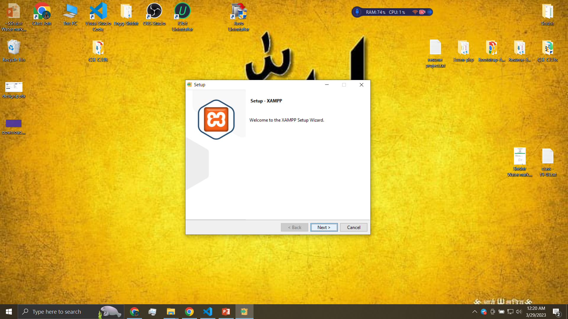
1. Install XAMP and write short notes about XAMPP on every Components.
XAMPP is a software package that allows you to create a web server environment on your computer. The name XAMPP is an acronym for cross-platform, Apache, MySQL, PHP, and Perl. These are the components that make up the XAMPP package.
Apache: Apache is an open-source web server software that allows you to host websites and web applications. It is the most widely used web server software in the world, and XAMPP includes Apache as its web server component.
MySQL: MySQL is a popular open-source relational database management system that is used to store data for web applications. It is included in XAMPP to provide a local database solution for web development.
FileZilla: FileZilla is an FTP client that allows you to transfer files between your local machine and a remote server. It is included in XAMPP to provide a local FTP solution for web development.
Mercury Mail Transport System: Mercury Mail Transport System is a mail server that allows you to send and receive emails on your local machine. It is included in XAMPP to provide a local email solution for web development.
PHP: PHP is a server-side scripting language that is used to create dynamic web content. It is widely used in web development, and XAMPP includes PHP to allow you to create and test PHP-based web applications on your local machine.
phpMyAdmin: phpMyAdmin is a web-based tool for managing MySQL databases. It allows you to easily create, edit, and delete databases and tables, as well as run SQL queries.

Slide 3
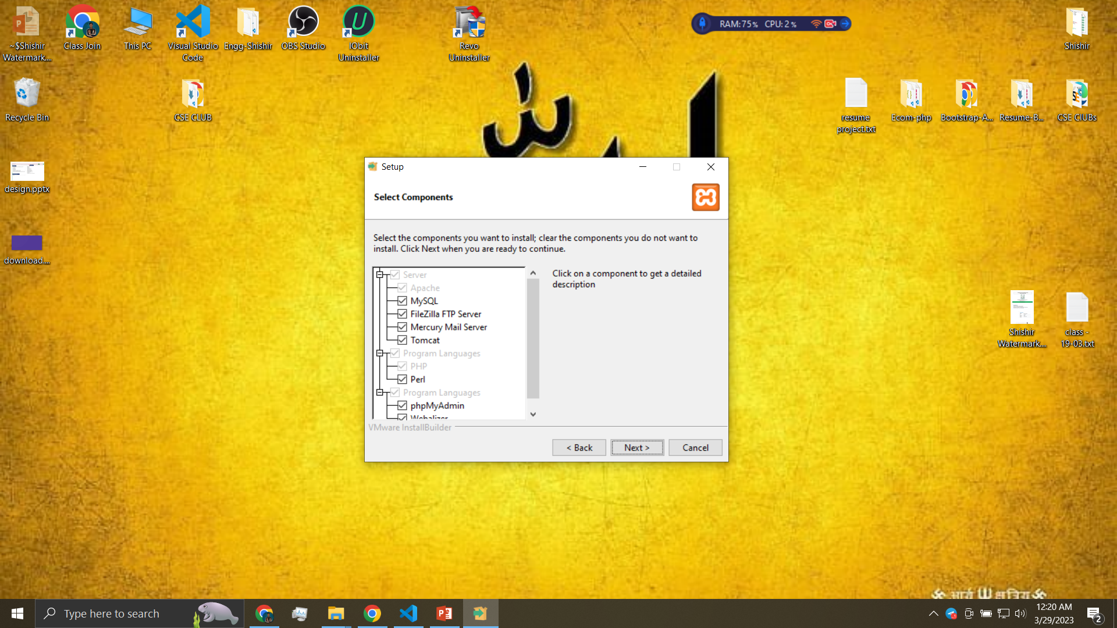
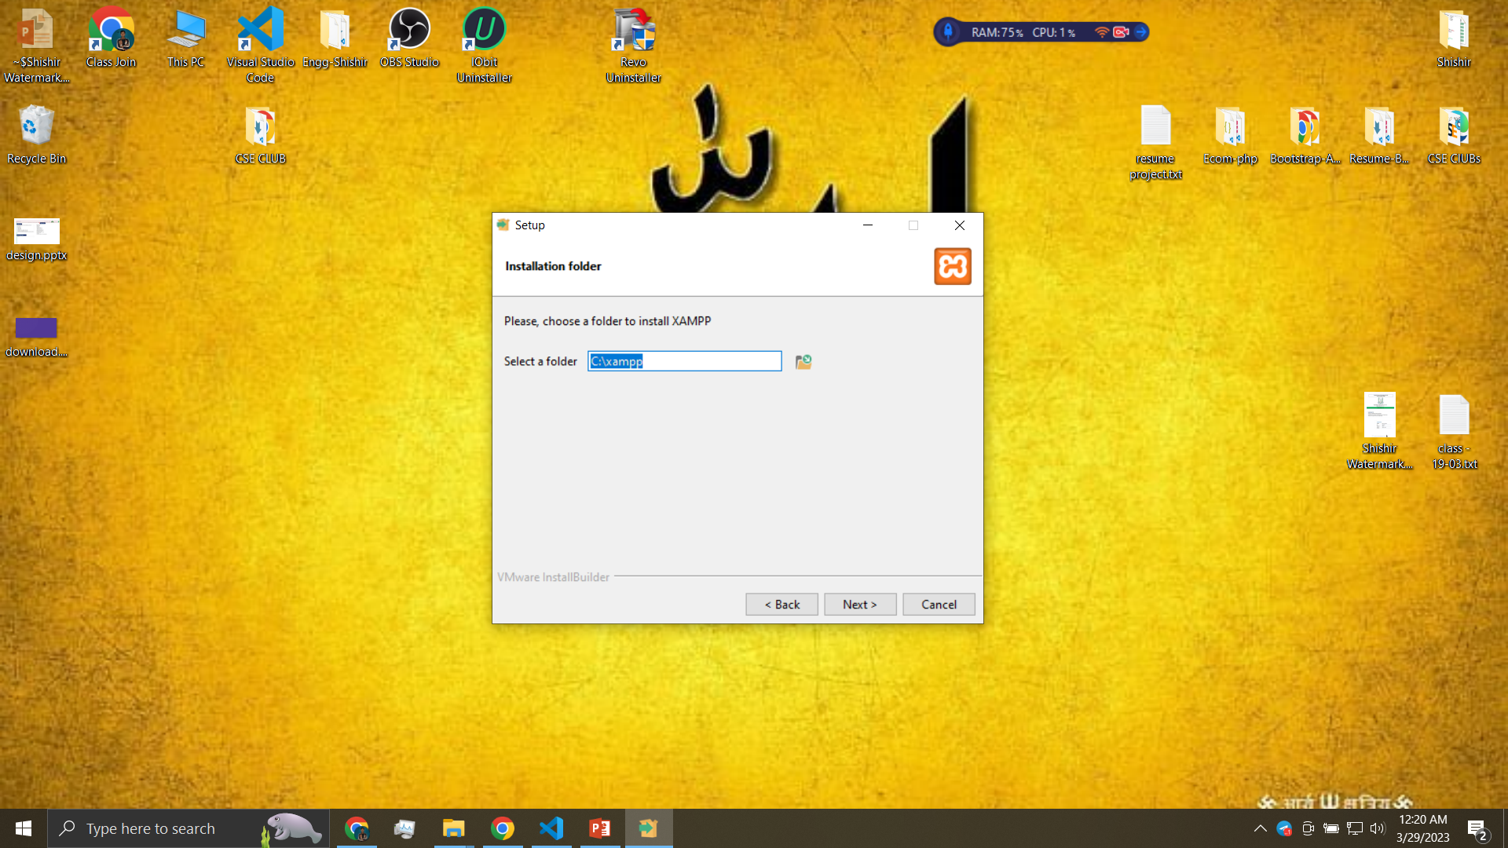

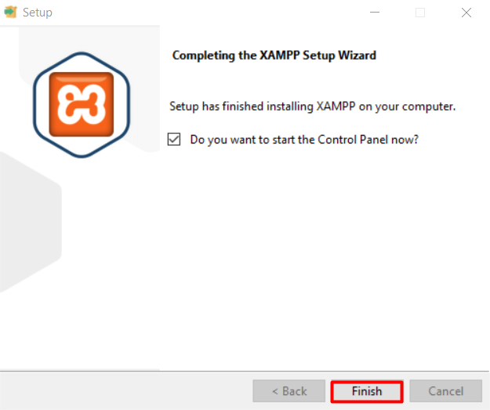
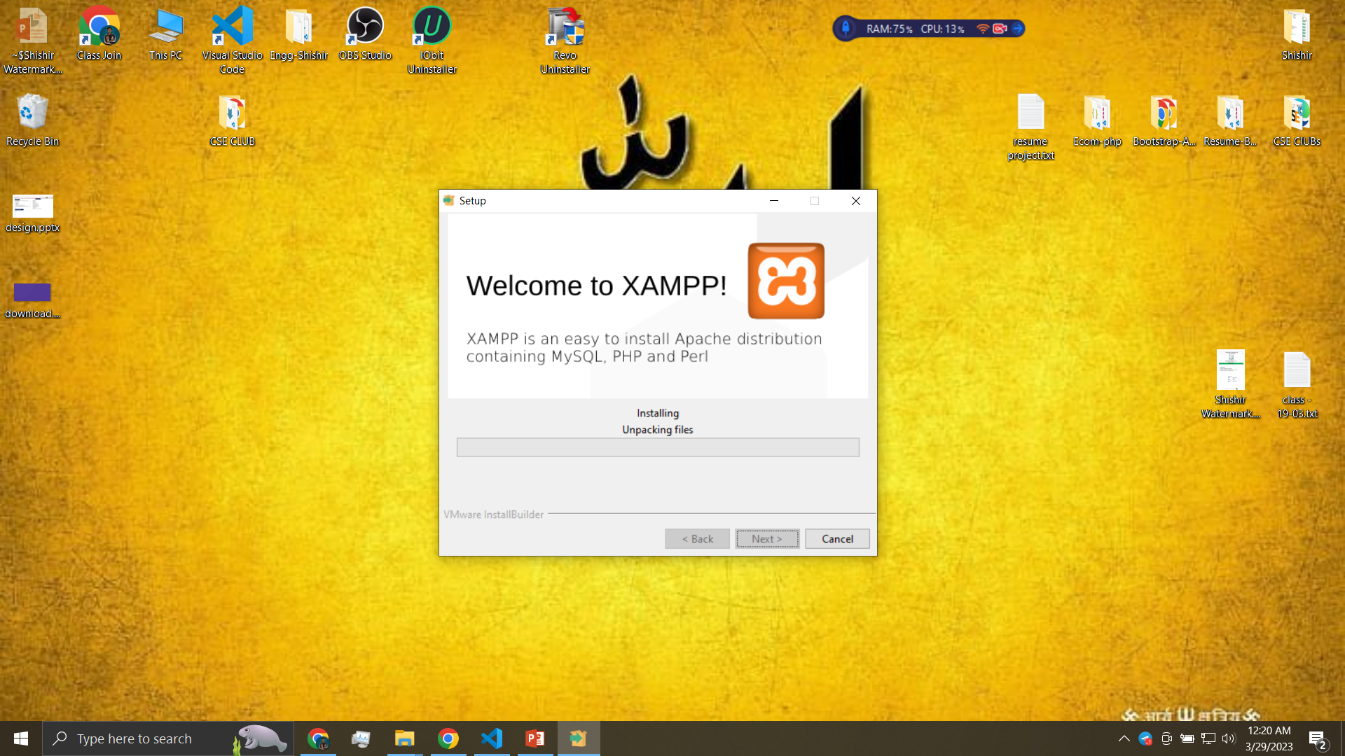
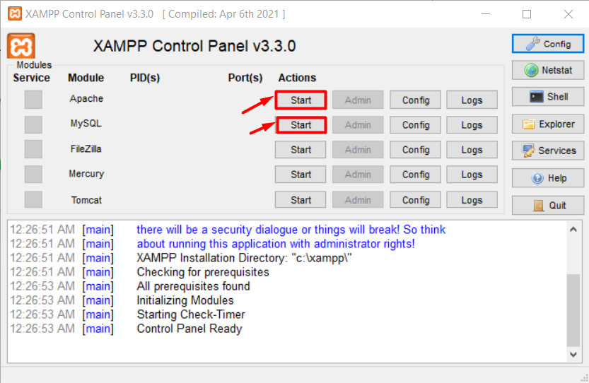

Slide 4
2. Create a Database as your id name and create all the table that discuss in the university database schema as below.
Create database
CREATE DATABASE Mohidul_1902016;
classroom(building, room_number, capacity)
CREATE TABLE Classroom ( building VARCHAR(255), room_number INT, capacity INT );
department(dept_name, building, budget)
CREATE TABLE department ( dept_name VARCHAR(20), building VARCHAR(15), budget NUMERIC(12, 2), PRIMARY KEY (dept_name) );
course(course_id, title, dept_name, credits)
CREATE TABLE course ( course_id VARCHAR(7), title VARCHAR(50), dept_name VARCHAR(20), credits NUMERIC(2,0), PRIMARY KEY (course_id), FOREIGN KEY (dept_name) REFERENCES department(dept_name) );
instructor(ID, name, dept_name, salary)
CREATE TABLE instructor ( ID VARCHAR(5), name VARCHAR(20) NOT NULL, dept_name VARCHAR(20), salary NUMERIC(8,2), PRIMARY KEY (ID), FOREIGN KEY (dept_name) REFERENCES department(dept_name) );

Slide 5
section(course_id, sec id, semester, year, building, room_number, time_slot_id)
CREATE TABLE section ( course_id VARCHAR(8), sec_id VARCHAR(8), semester VARCHAR(6), year NUMERIC(4,0), building VARCHAR(15), room_number VARCHAR(7), time_slot_id VARCHAR(4), PRIMARY KEY (course_id, sec_id, semester, year), FOREIGN KEY (course_id) REFERENCES course(course_id) );
teaches(ID, course_id, sec_id, semester, year)
CREATE TABLE teaches ( ID VARCHAR(5), course_id VARCHAR(8), sec_id VARCHAR(8), semester VARCHAR(6), year NUMERIC(4,0), PRIMARY KEY (ID, course_id, sec_id, semester, year), FOREIGN KEY (course_id, sec_id, semester, year) REFERENCES section(course_id, sec_id, semester, year), FOREIGN KEY (ID) REFERENCES instructor(ID) );
student(ID, name, dept_name, tot cred)
CREATE TABLE student ( ID VARCHAR(5), name VARCHAR(20) NOT NULL, dept_name VARCHAR(20), tot_cred NUMERIC(3, 0), PRIMARY KEY (ID), FOREIGN KEY (dept_name) REFERENCES department(dept_name) );
takes(ID, course_id, sec_id, semester, year, grade)
CREATE TABLE takes ( ID VARCHAR(5), course_id VARCHAR(255), sec_id VARCHAR(255), semester VARCHAR(255), year NUMERIC(4), grade VARCHAR(2), PRIMARY KEY (ID), FOREIGN KEY (ID) REFERENCES student(ID), FOREIGN KEY (course_id, sec_id, semester, year) REFERENCES section(course_id, sec_id, semester, year) );

Slide 6
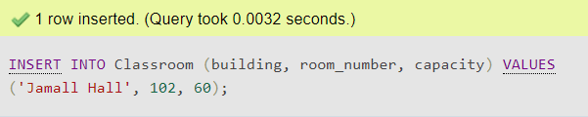
advisor(s_ID, i_ID)
CREATE TABLE IF NOT EXISTS advisor ( s_ID VARCHAR(5), i_ID CHAR(5), PRIMARY KEY (s_ID), FOREIGN KEY (s_ID) REFERENCES student(ID), FOREIGN KEY (i_ID) REFERENCES instructor(ID) );
time slot(time_slot_id, day, start_time, end_time)
CREATE TABLE time_slot ( time_slot_id VARCHAR(255), day VARCHAR(255), start_time VARCHAR(255), end_time VARCHAR(255), PRIMARY KEY (time_slot_id) );
prereq(course_id, prereq_id)
CREATE TABLE prereq ( course_id VARCHAR(255), prereq_id VARCHAR(255), PRIMARY KEY (course_id, prereq_id), FOREIGN KEY (course_id) REFERENCES course(course_id) );
3. Solve all the queries in Chapter 3 Introduction to SQL Lecture basis on 21.03.2023. Write the query first and then write the SQL solution
Insert into Classroom Table
INSERT INTO Classroom (building, room_number, capacity) VALUES (Jamall Hall', 102, 60);

Slide 7
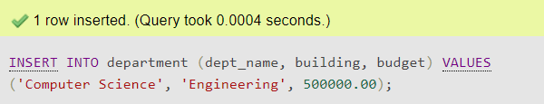
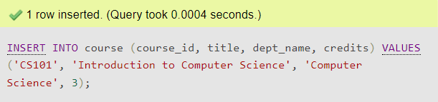
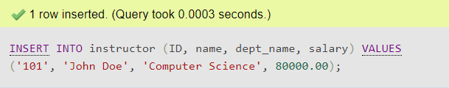
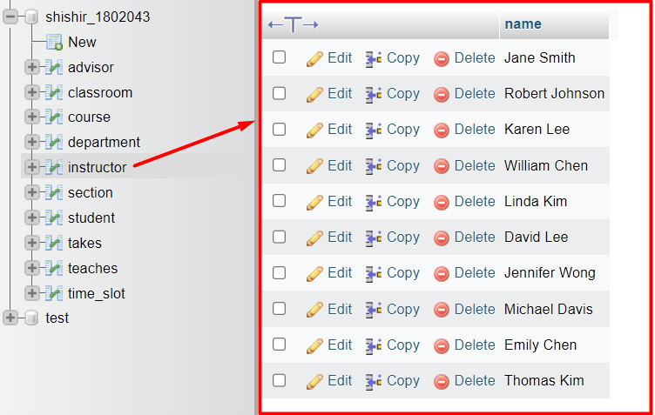
Insert into department Table
INSERT INTO department (dept_name, building, budget) VALUES ('Computer Science', 'Engineering', 500000.00);
Insert into course Table
INSERT INTO course (course_id, title, dept_name, credits) VALUES ('CS101', 'Introduction to Computer Science', 'Computer Science', 3);
Insert into instructor Table
INSERT INTO instructor (ID, name, dept_name, salary) VALUES ('101', 'John Doe', 'Computer Science', 80000.00);
select name from instructor;

Slide 8
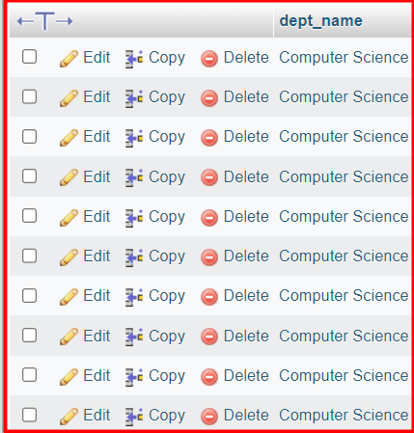
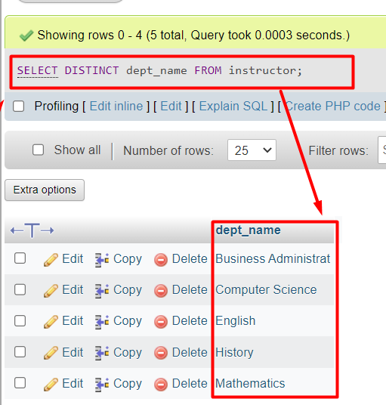
SELECT dept_name FROM instructor;
SELECT DISTINCT dept_name FROM instructor;

Slide 9
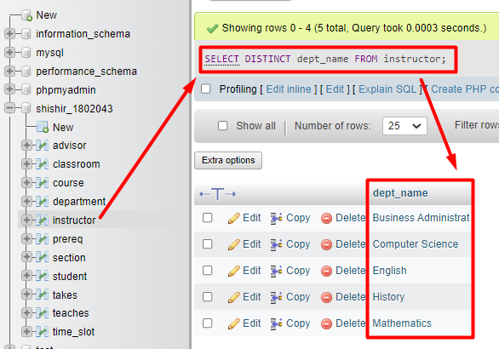
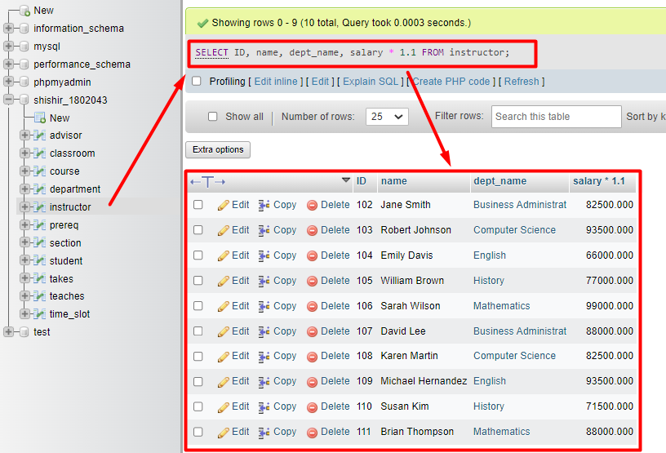
SELECT DISTINCT dept_name FROM instructor;
SELECT ID, name, dept_name, salary * 1.1 FROM instructor;

Slide 10
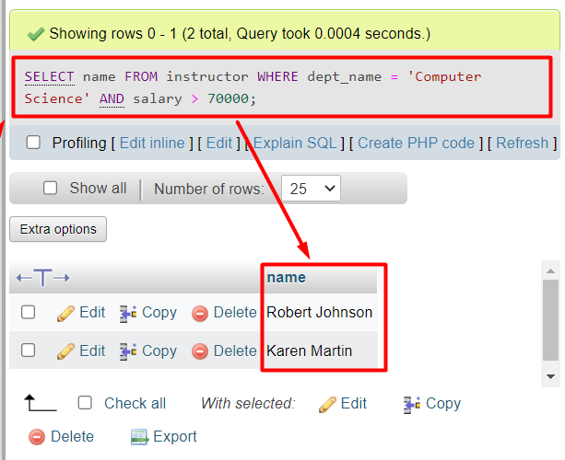
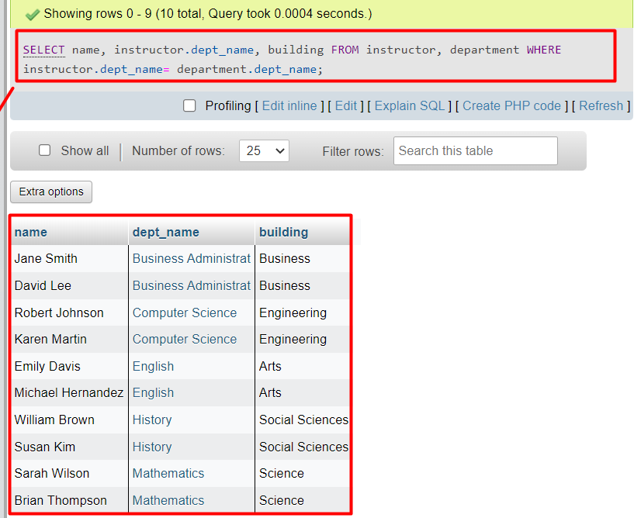
SELECT name FROM instructor WHERE dept_name = 'Computer Science' AND salary > 70000;
SELECT name, instructor.dept_name, building FROM instructor, department WHERE instructor.dept_name= department.dept_name;

Slide 11
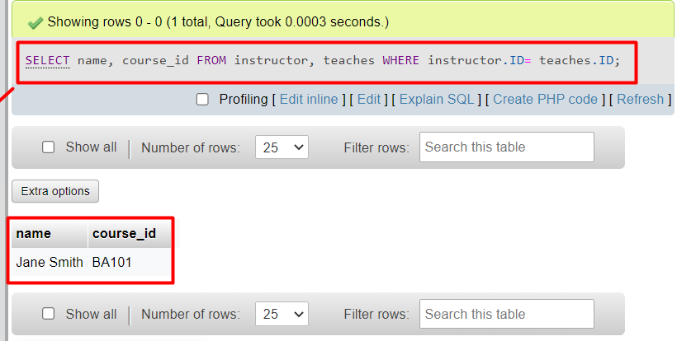
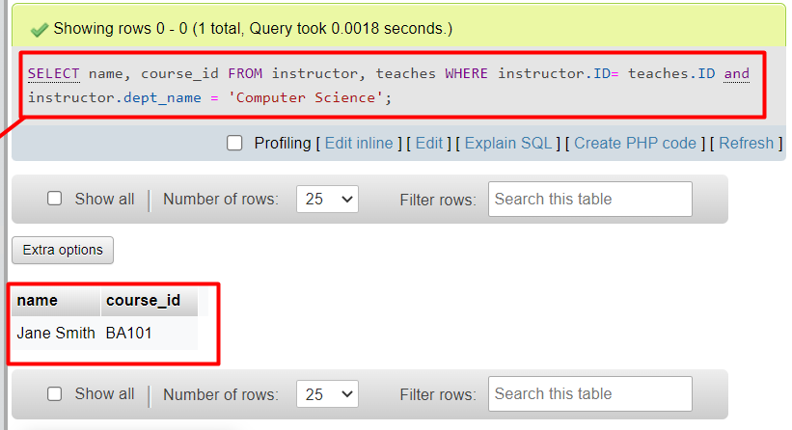
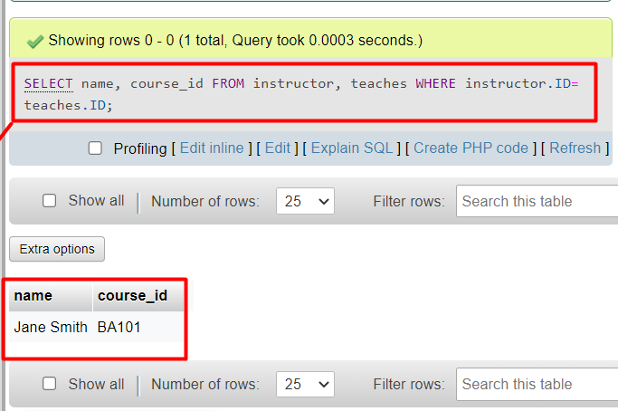
SELECT name, course_id FROM instructor, teaches WHERE instructor.ID= teaches.ID;
SELECT name, course_id FROM instructor, teaches WHERE instructor.ID= teaches.ID and instructor.dept_name = 'Computer Science';
SELECT name, course_id FROM instructor, teaches WHERE instructor.ID= teaches.ID;

Slide 12
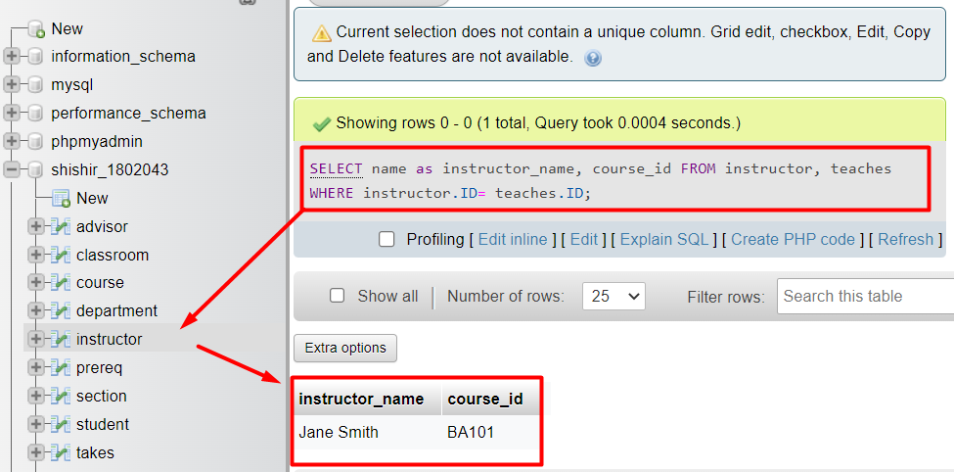
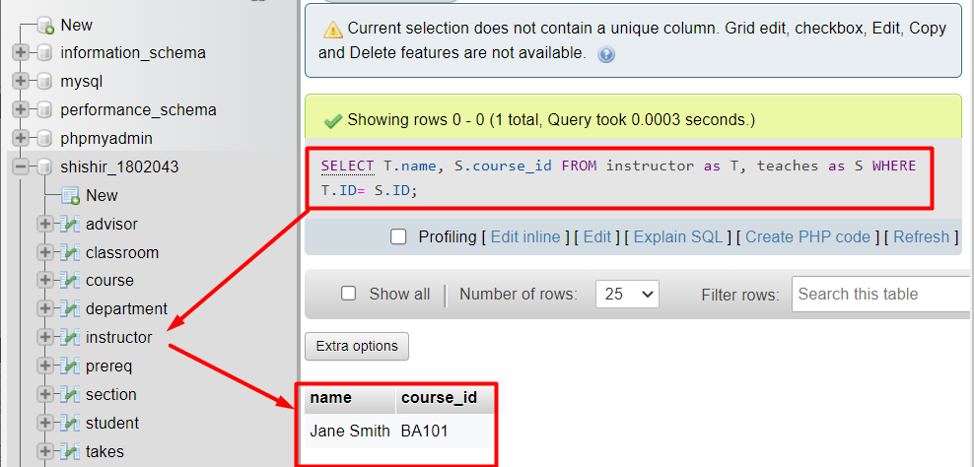
SELECT name as instructor_name, course_id FROM instructor, teaches WHERE instructor.ID= teaches.ID;
SELECT T.name, S.course_id FROM instructor as T, teaches as S WHERE T.ID= S.ID;

Slide 13
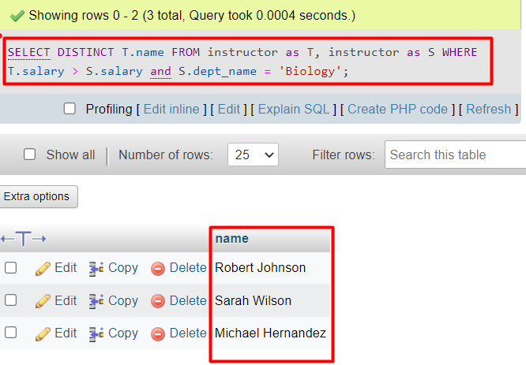
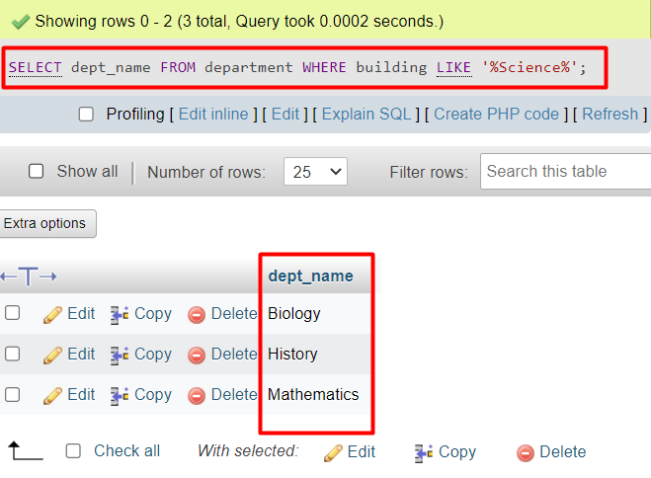
SELECT DISTINCT T.name FROM instructor as T, instructor as S WHERE T.salary > S.salary and S.dept_name = 'Biology';
SELECT dept_name FROM department WHERE building LIKE '%Science%';

Slide 14
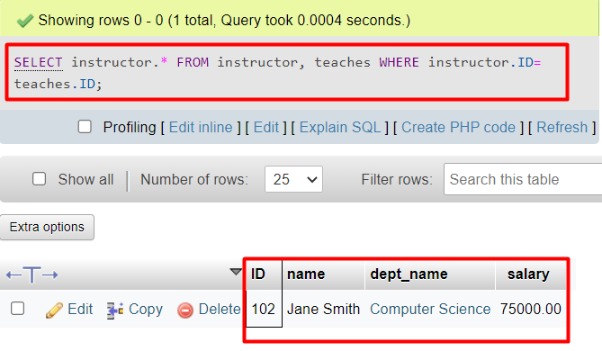
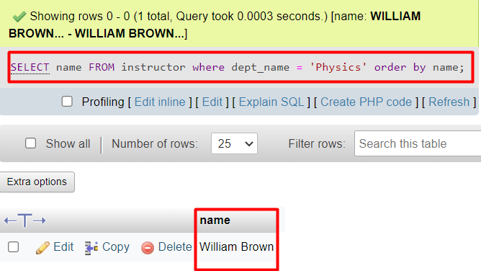
SELECT instructor.* FROM instructor, teaches WHERE instructor.ID= teaches.ID;
SELECT name FROM instructor where dept_name = 'Physics' order by name;

